Slide 1
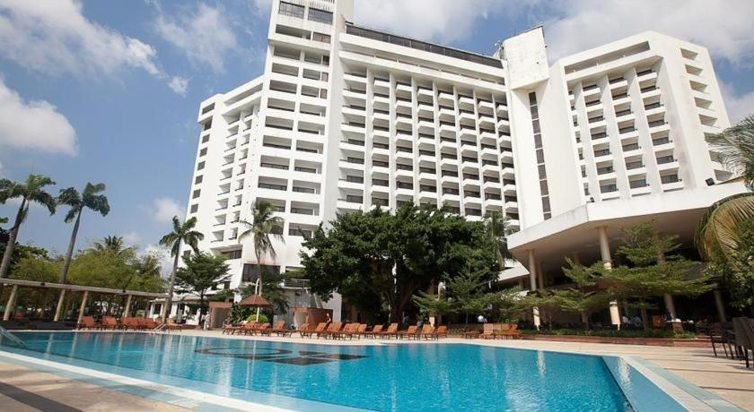
Hotel Reservation Analysis with SQL
Presented by: Odiniya Princess Ojone

Slide 2
Table of contents
01
02
03
04
Dataset Details
Project overview
Analysis Questions & Answers
Insight from the Analysis

Slide 3
Project Overview
In this Internship project, I analyze hotel reservations using SQL, leveraging a dataset to gain insights into guest preferences and booking trends. Through SQL queries, I uncover key patterns such as popular meal plans, average prices for child-inclusive reservations, room preferences and the distribution of bookings across market segments. Our analysis identifies revenue optimization opportunities by highlighting market segments with the highest average room prices. This project equips me with practical SQL skills for data-driven decision-making in the hospitality industry.

Slide 4
Dataset Details
Booking_ID: A unique identifier for each hotel reservation.
No_of_adults: The number of adults in the reservation.
No_of_children: The number of children in the reservation.
No_of_weekend_nights: The number of nights in the reservation that fall on weekends.
No_of_week_nights: The number of nights in the reservation that fall on weekdays.
Type_of_meal_plan: The meal plan chosen by the guests.
Room_type_reserved: The type of room reserved by the guests.
Lead_time: The number of days between booking and arrival.
Arrival_date: The date of arrival.
Market_segment_type: The market segment to which the reservation belongs.
Avg_price_per_room: The average price per room in the reservation.
Booking_status: The status of the booking.

Slide 5

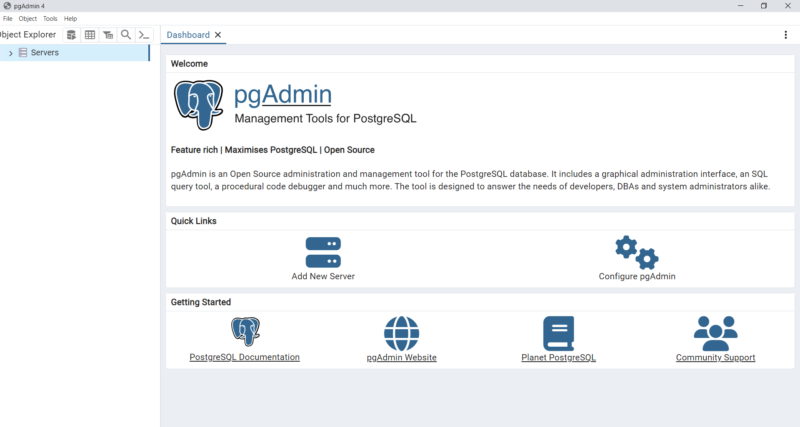
Database used

Slide 6
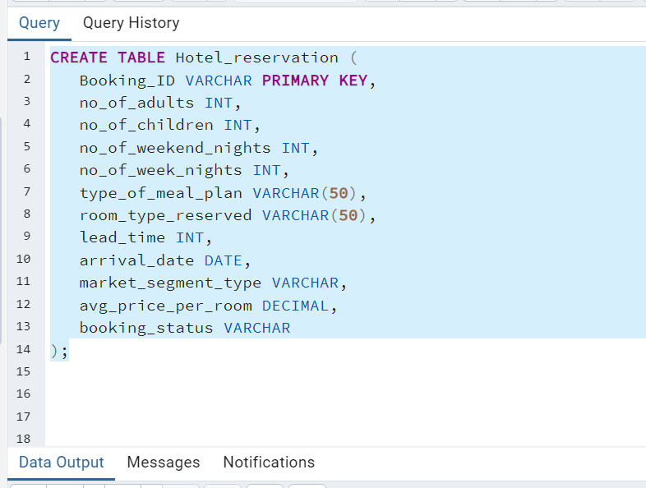
Database Setup and Table Creation

Slide 7
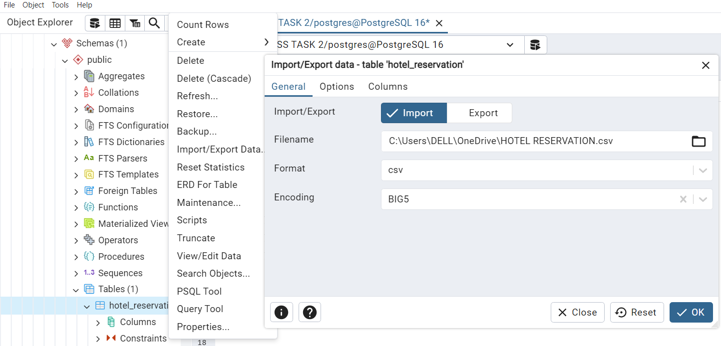
Importing Data into the Table

Slide 8
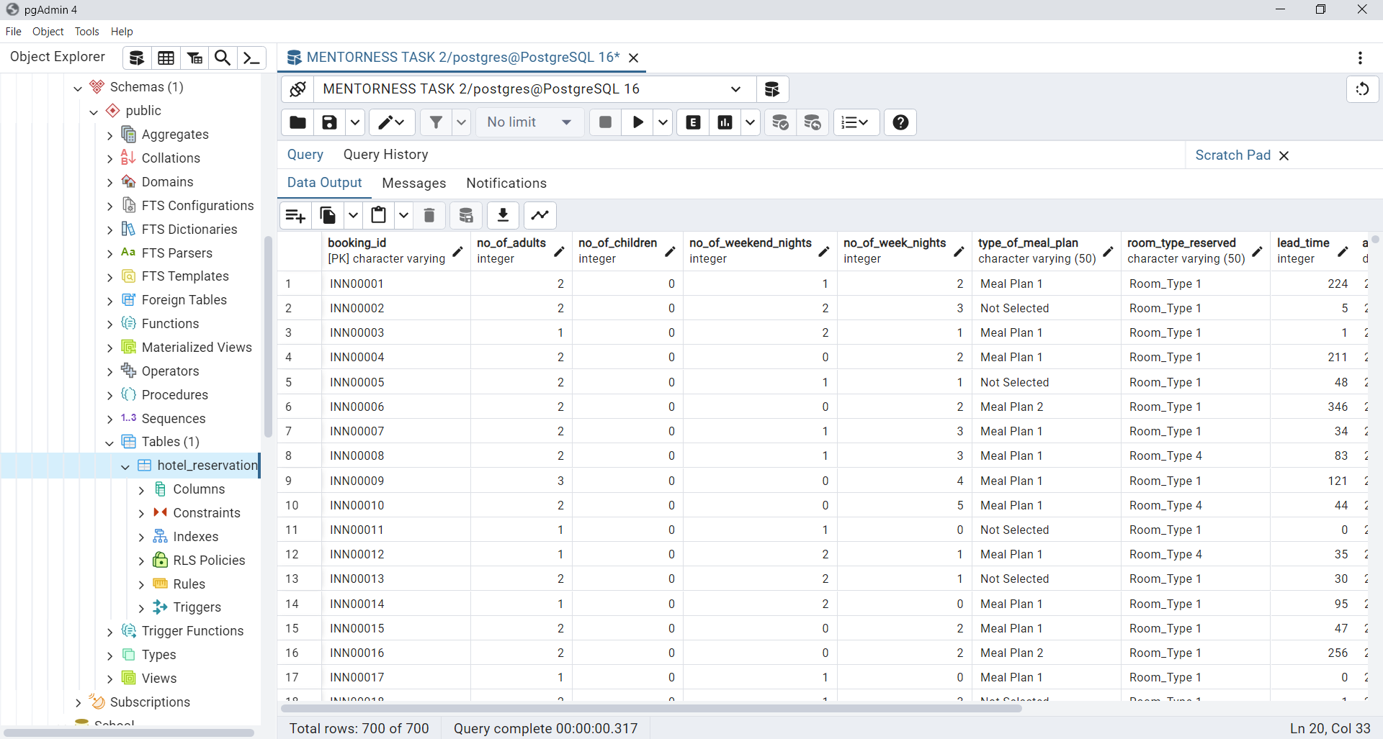
Imported Data

Slide 9
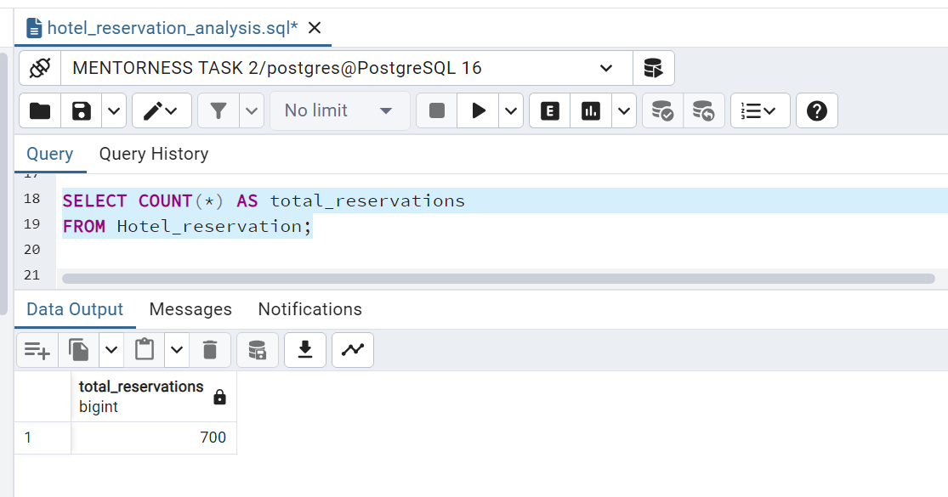
What is the total number of reservations in the dataset?
The total number of reservations in the database is 700

Slide 10
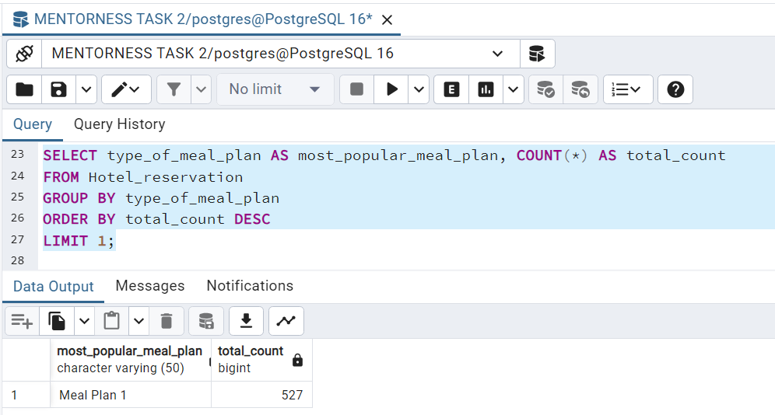
Which meal plan is the most popular among guests?
Meal Plan 1 stands out as the most favoured choice among guests, with a substantial count of 527 reservations. This insight highlights guest preferences, enabling hotels to tailor services accordingly for enhanced guest satisfaction and operational efficiency.

Slide 11
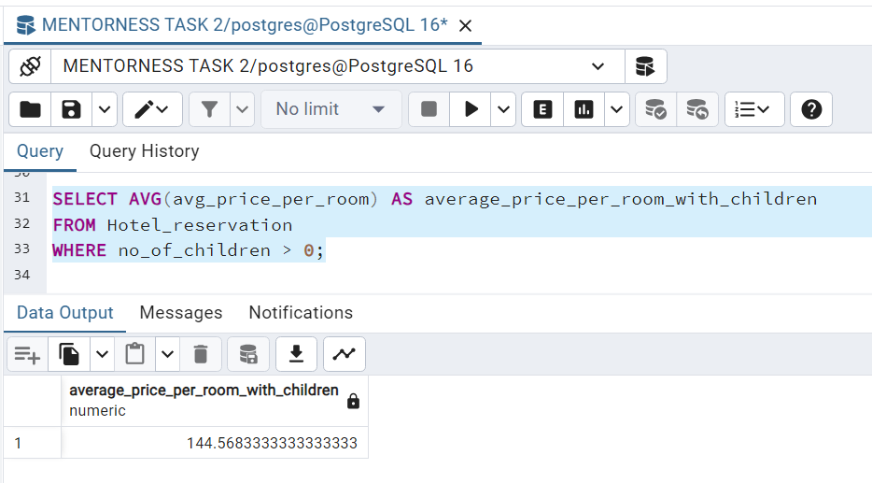
What is the average price per room for reservations involving children?
Reservations involving children have an average room price of 144.57. This suggests a slight premium, potentially reflecting tailored amenities for families. This insight informs pricing strategies for family accommodations, optimizing profitability while meeting guest preferences.

Slide 12
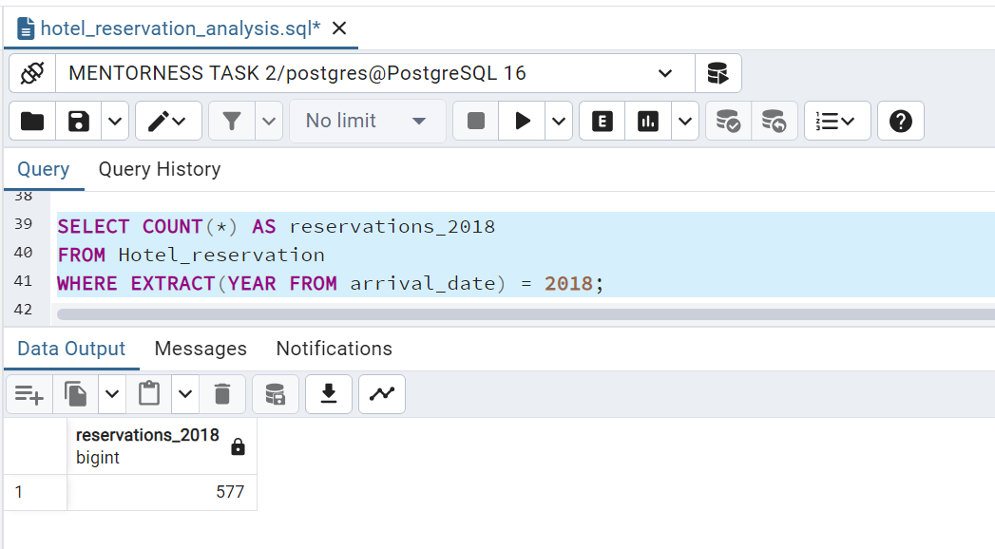
How many reservations were made for the year 20xx(replace xx with desired year)
In the year 2018, the hotel recorded 577 reservations, providing a key metric for understanding booking trends and informing operational decisions.
Additionally, by analyzing historical booking data, hotel operators can identify trends, seasonality effects, and potential areas for growth or improvement in their operations.

Slide 13
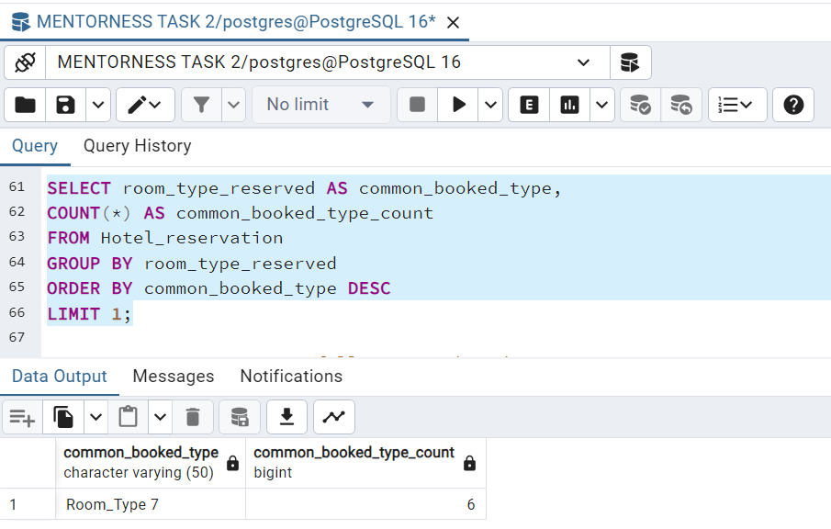
What is the most commonly booked room type?
Room_Type 7 is the most commonly booked room type, with 6 reservations. This indicates a strong guest preference for this accommodation option, guiding hotels to allocate resources efficiently and tailor services to meet demand.

Slide 14
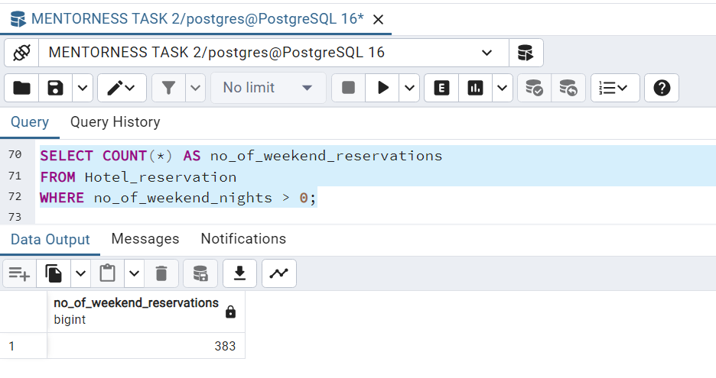
How many reservations fall on a weekend?
With 383 reservations falling on weekends, it's evident that weekends attract a considerable share of our bookings. Understanding this trend allows us to optimize staffing, amenities, and promotional efforts to cater specifically to weekend guests, enhancing their overall experience and potentially increasing revenue.

Slide 15
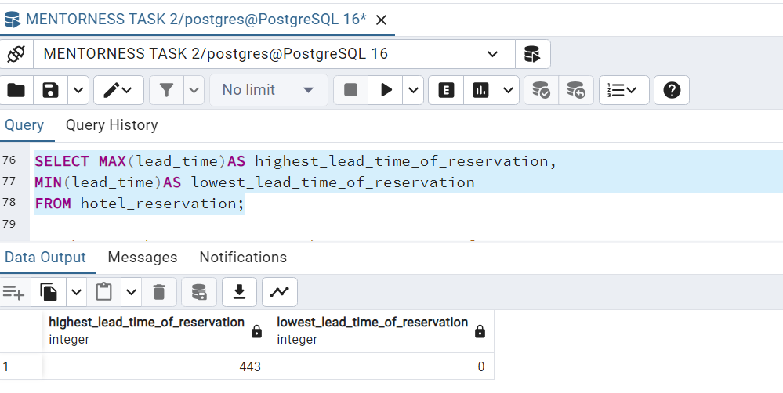
What is the highest and lowest lead time of reservation?
In examining reservation lead times, we uncover a striking contrast: the highest lead time extends to 443 days, indicating reservations made well in advance. Conversely, the lowest lead time registers at 0 days, suggesting last-minute bookings. This disparity underscores the diverse booking behaviours within our guest demographic, prompting consideration for tailored strategies to cater to both early planners and impromptu travellers.

Slide 16
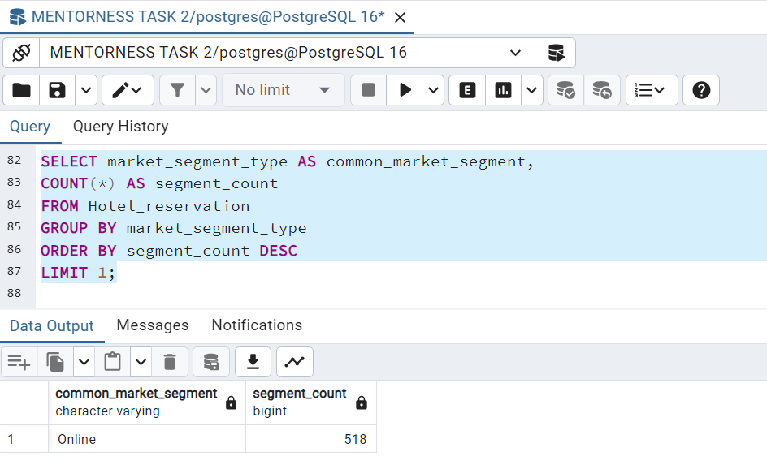
What is the most common market segment type for reservation?
Online reservations dominate the market segment, comprising 518 bookings, indicating a strong preference for digital booking channels among guests. This insight highlights the significance of online platforms in driving hotel reservations, underscoring the importance of digital marketing and e-commerce strategies for hotels to effectively reach and engage with their target audience.

Slide 17
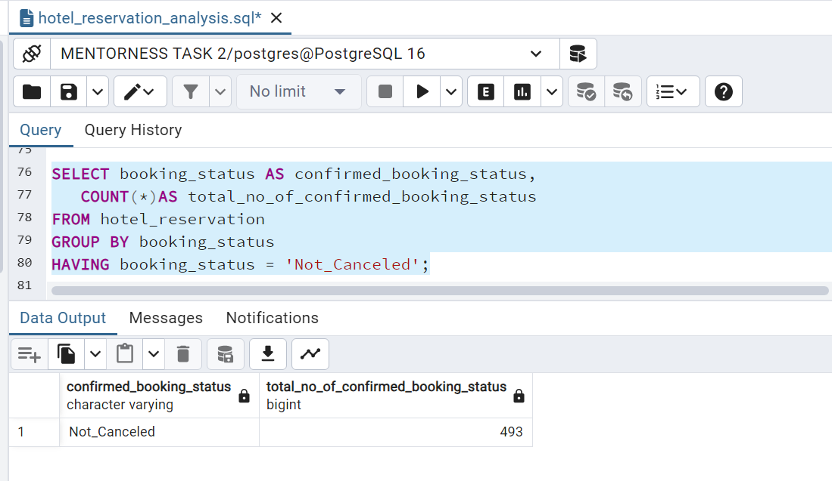
How many reservation have a booking status of "confirmed"
The dataset reveals that there are a total of 493 reservations with a booking status of "Not_canceled". This indicates that these reservations were successfully booked and not cancelled.

Slide 18
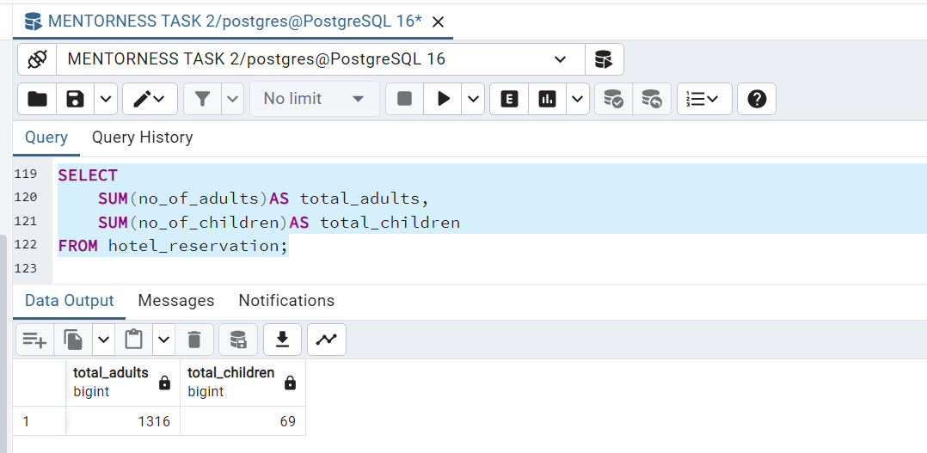
What is the total number of adults and children across all reservation?
The total number of adults across all reservations is 1,316, while the total number of children is 69. This indicates that the majority of the reservations are made by adults, with a relatively small number of children included in the bookings. This trend may suggest that the hotel caters primarily to adult guests or that most family reservations include only a few children.

Slide 19
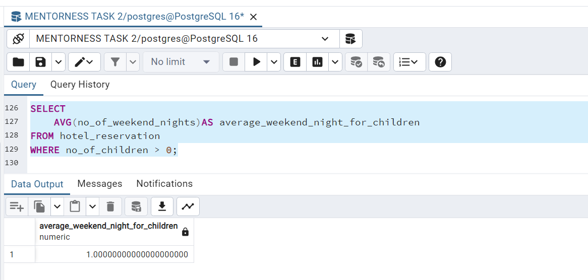
What is the average number of weekends night for reservations involving children?
The average number of weekend nights for reservations involving children is 1. This suggests that families with children typically stay for one weekend night.

Slide 20
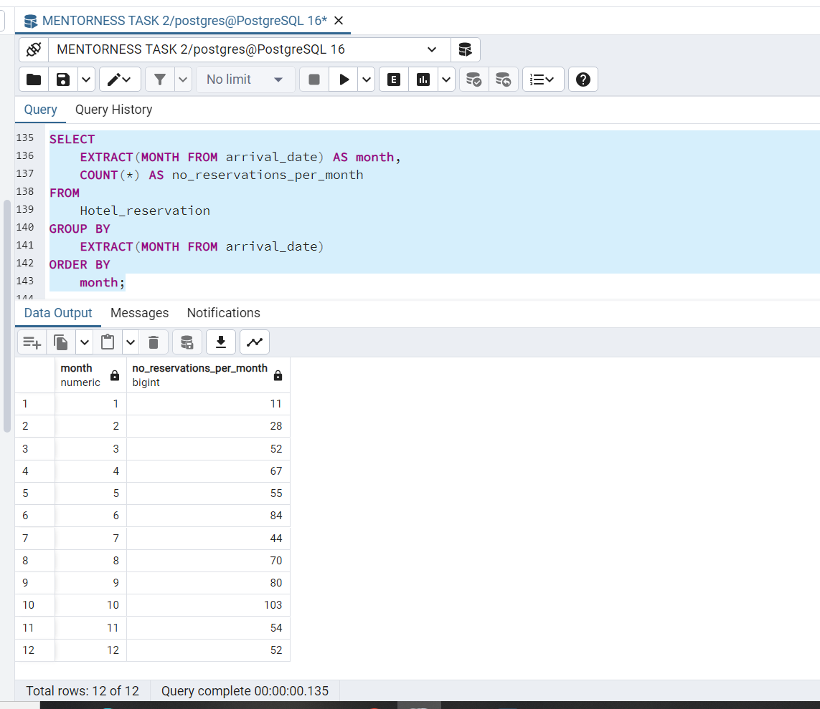
How many reservation was made in each month of the year?
From this data, we observe that Month 10 had the highest number of reservations (103), while Month 1 had the lowest (11). There is a noticeable increase in reservations from the beginning of the year, peaking in October, followed by a decline towards the end of the year.

Slide 21
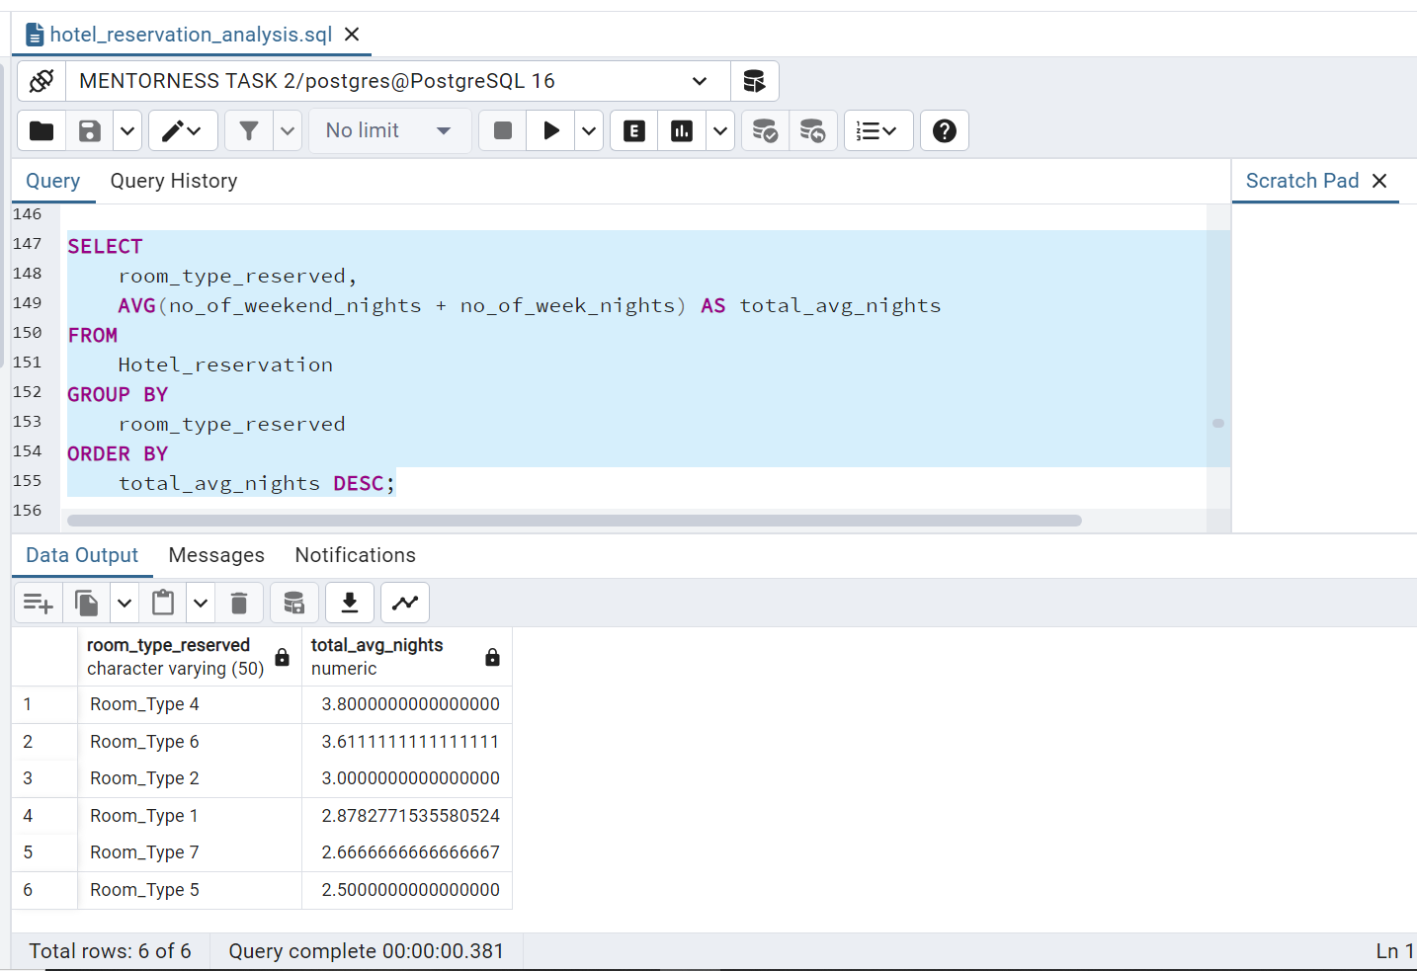
What is the average number of night (both weekend and weekday) spent by guest for each room type?
These insights suggest that Room_Type 4 and Room_Type 6 are preferred for longer stays, while Room_Type 5 is typically chosen for shorter visits. This information could be valuable for optimizing room pricing, marketing strategies, and resource allocation based on guest behavior and preferences.

Slide 22
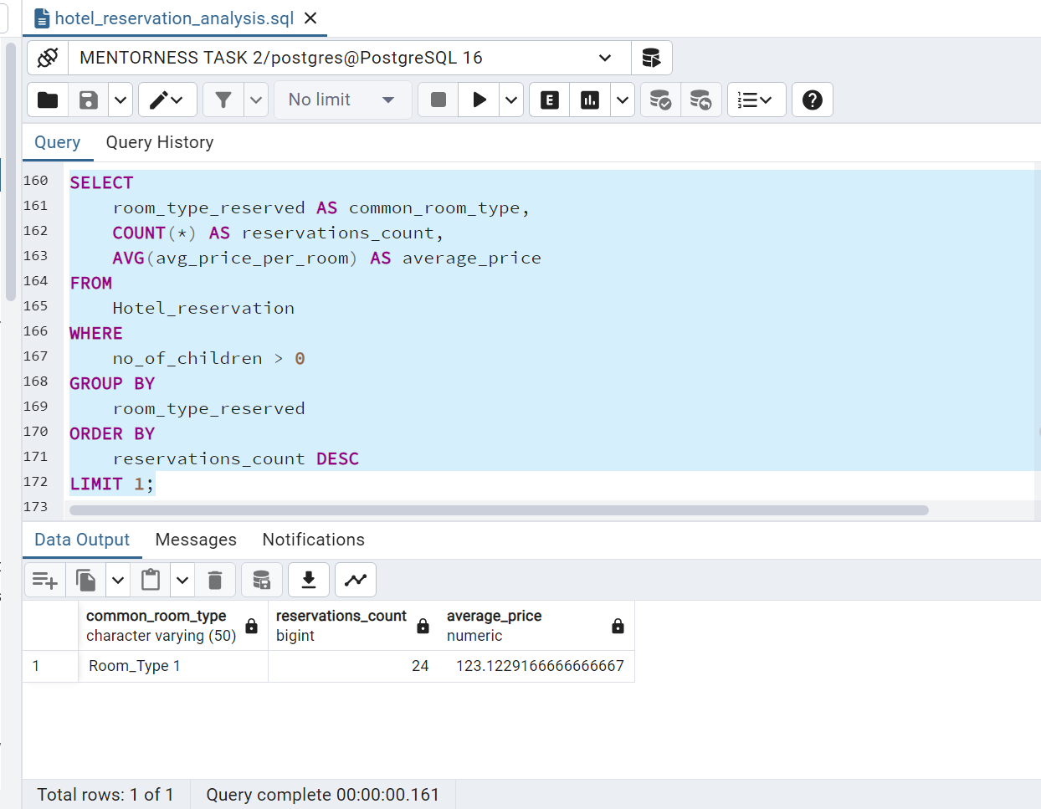
For reservations involving children, what is the common room type ,and what is the average price
for that room type?
For hotel reservations that include children, the most common room type is Room Type 1. This room type accounts for a total of 24 reservations. The average price per room for these reservations is approximately 123.12.

Slide 23
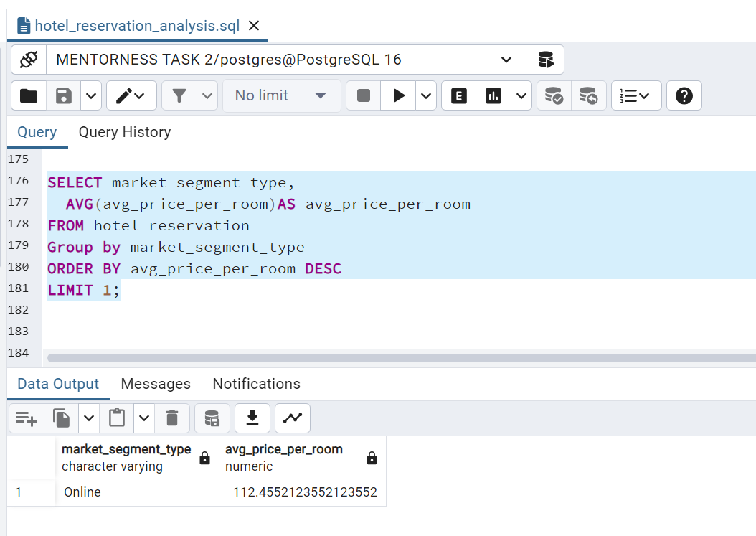
Find the market segment type that generates the highest average price per room
Based on the analysis of the hotel reservation data, the market segment type that generates the highest average price per room is the "online" segment, with an average price per room of approximately 112.46. This indicates that bookings made through online channels tend to have higher room rates compared to other market segments.

Slide 24
Insight from the Analysis
The analysis of the hotel reservation dataset provides several key insights. With 700 total reservations, Meal Plan 1 is the most popular with 527 choices. Reservations with children have an average price of 144.57 per room. In 2018, there were 577 reservations. Room_Type 7 is the most booked with 6 reservations. Weekends have 383 bookings. Lead times range from 0 to 443 days, showing diverse behaviours. Online bookings dominate with 518 reservations, also generating the highest average room price at 112.46. There are 493 confirmed bookings. Families typically stay for one weekend night, with Room_Type 1 being the preferred choice at 123.12. Month 10 has the highest bookings, while Month 1 has the lowest. These insights help in strategic planning and improving guest satisfaction.

Slide 25


